Slide 1
Unit 2
Biometrics

Slide 2
Topics
Biometric Sensors and Data Acquition
Biometric Data Acquition and Database
Biometric Pre-processing
Biometric Processing and Technologies
Image Restoration & Segmentation
Pattern Extraction & Classification
Fingerprint Recognition & Acquisition
Fingerprint features, matching and synthesis
Face Recognition & Acquisition
Face Detection, feature extraction and matching
Iris recognition & Acquisition
Iris segmentation, normalization and matching
Ear Recognition and Detection
Hand Geometry Features and Palm print features

Slide 3
Session 1
Biometric Sensors and Data Acquition
Biometric Data Acquition and Database

Slide 4
Biometric sensors
A biometric sensor is a transducer that changes a biometric traits of a person into an electrical signal.
Every biometric device requires at least one type of sensor
The working of a sensor may be based on the measurement of one or more physical quantities like light intensity, capacitance, temperature, image, etc.

Slide 5
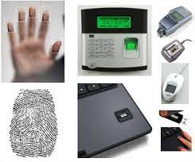
Biometric sensors

Slide 6
Types of Biometric Sensors
Biometrics is broadly divided into three categories as follows
Biological biometrics
Morphological biometrics
Behavioral biometrics

Slide 7
Types of Biometric Sensors
Biological biometrics sensors involve biological measurements at the genetic or molecular level, and DNA sequencing is a biological biometric system.
It requires the sampling of DNA from blood or bodily fluids.
This cannot be used for security or authentication systems but has other practical applications like DNA matching, genetic diseases, and microbiological studies.

Slide 8
Types of Biometric Sensors
Morphological biometrics sensors involve the measurement of physical traits and body structures.
The security and authentication systems are usually based on one or more morphological biometrics.
This includes fingerprint mapping, iris scan, face recognition, finger geometry recognition, vein recognition, hand geometry, ear recognition, and odour recognition.

Slide 9
Types of Biometric Sensors
Behavioral biometrics sensors involve the measurement of behavioral identifiers unique to a person.
These systems are not common but are reserved for special applications.
This includes signature recognition, voice biometrics, gait biometrics, keystroke recognition, and gesture recognition.

Slide 10
Data Collection subsystem
Also called Data Acquisition
Comprises input device or sensor that reads the biometric information from the user
Converts biometric information into a suitable form for processing by the remainder of the biometric system
Examples: video camera, fingerprint scanner, digital tablet, microphone, etc.
Notes:
The data acquisition module contains the input device or sensor that reads the biometric information from the user. It is the link between the physical domain and the logical domain.
Interface between man and machine.
In order to recognise a user successfully, the sampled biometric characteristic must be similar to the user’s reference template to which it is compared. This imposes requirements on the data collection sensor, and may impose training requirements for the users. All sensors in a given system must be similar enough that a feature collected by one sensor will closely match the same feature collected at other sensors – and also that collected during enrolment – so that the user can be recognized at any location.
Depending on the biometric technology being used, environmental conditions such as lighting, background noise, weather, can impact on the performance of the data acquisition module.

Slide 11
Challenges in Data Collection
The biometric features may change
The presentation of the biometric feature at the sensor may change
The performance of the sensor itself may change
The surrounding environmental conditions may change
Notes:
Environment – temperature, humidity, background noise

Slide 12
Image Preprocessing
Preprocessing involves steps to make image suitable for feature extraction and matching
Most of the engineers spend a good amount of time in data pre-processing before building the model.
The aim of pre-processing is an improvement of the image data that suppresses undesired distortions or enhances some image features relevant for further processing and analysis task.

Slide 13
Image Preprocessing
The steps to be taken are :
Read image
Image Enhancement
Remove noise
Segmentation
Removing Specular Highlights
Region of Interest Detection and so on…
Morphology(smoothing edges)

Slide 14
Image Enhancement
Image enhancement refers to the process of highlighting certain information of an image, as well as removing any unnecessary information according to specific needs.
The tools used for image enhancement include many different kinds of software such as filters, image editors and other tools for changing various properties of an entire image or parts of an image.
The principal objective of Image Enhancement is to modify attributes of an image to make it more suitable for a given task and a specific observer

Slide 15
Image Enhancement Techniques
Image Enhancement by Point Processing
Simple Intensity Transformation
Image Negatives
Contrast Stretching
Compression
Gray-level Slicing
Histogram Processing
Histogram Equalization
Histogram Specification
Local Enhancement

Slide 16
Image Enhancement by Point Processing
These processing methods are based only on the intensity of single pixels.
1. Simple intensity transformation:
a. Image Negatives
Negatives of digital images are useful in numerous applications, such as displaying medical images and photographing a screen with monochrome positive film with the idea of using the resulting negatives as normal slides

Slide 17
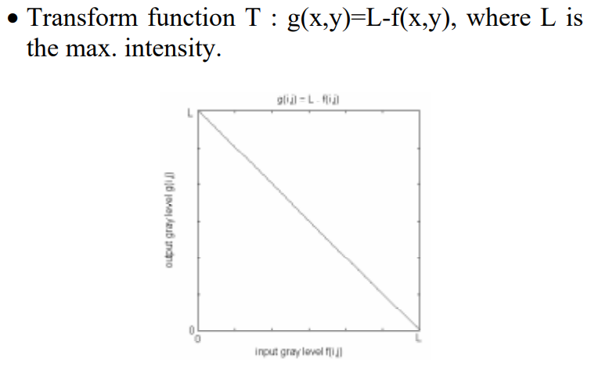
Image Enhancement by Point Processing

Slide 18
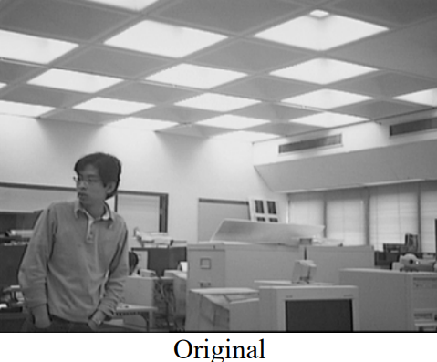
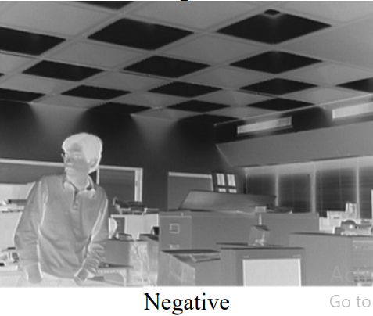
Image Enhancement by Point Processing

Slide 19
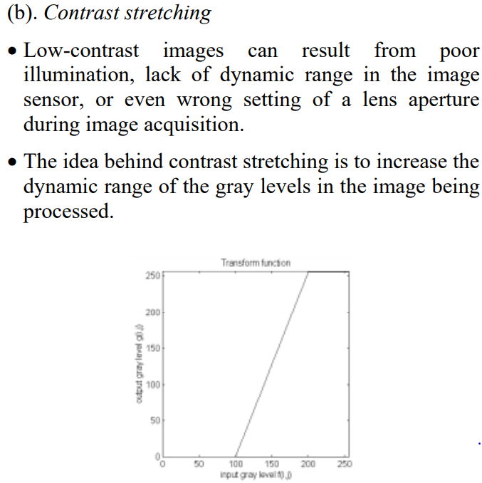
Image Enhancement by Point Processing

Slide 20
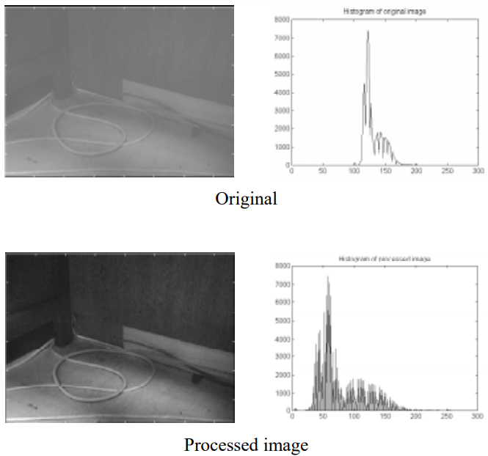
Image Enhancement by Point Processing

Slide 21
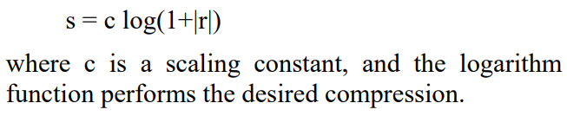
Image Enhancement by Point Processing
C) Compression of dynamic range
Sometimes the dynamic range of a processed image far exceeds the capability of the display device, in which case only the brightest parts of the images are visible on the display screen.
An effective way to compress the dynamic range of pixel values is to perform the following intensity transformation function:

Slide 22
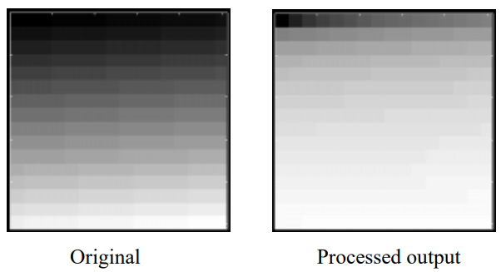
Image Enhancement by Point Processing

Slide 23
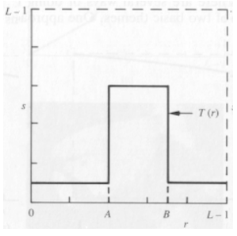
Image Enhancement by Point Processing
(d) Gray-level slicing
Highlighting a specific range of gray levels in an image often is desired.
Applications include enhancing features such as masses of water in satellite imagery and enhancing flaws in x-ray images
Example: A transformation function that highlights a range [A,B] of intensities while diminishing all others to a constant.

Slide 24
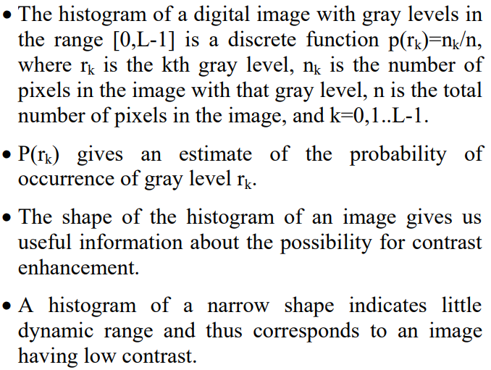
Image Enhancement by Point Processing
2 Histogram processing:

Slide 25
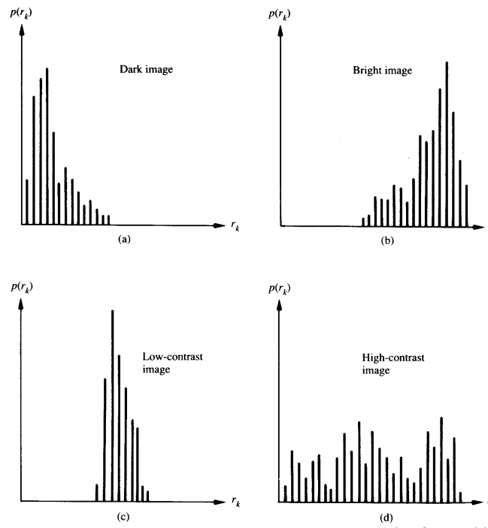
Image Enhancement by Point Processing
2 Histogram processing:

Slide 26
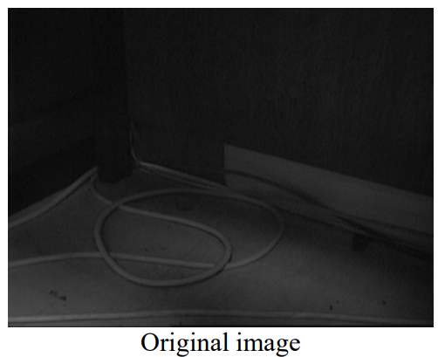
Image Enhancement by Point Processing

Slide 27
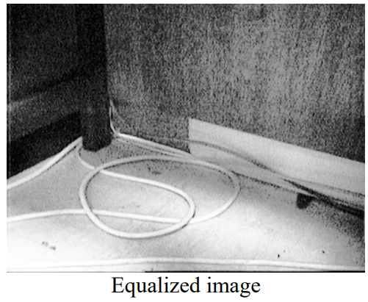
Image Enhancement by Point Processing

Slide 28
Removing Specular Highlights
Image contains specular highlights due to source of light
Such highlights can be removed in 2 stages
Adaptive Thresholding - Adaptive thresholding is the method where the threshold value is calculated for smaller regions and therefore, there will be different threshold values for different regions.
Hole Filling - The hole-filling method is to fill in the holes in the depth image captured from the sensors used for rendering.

Slide 29
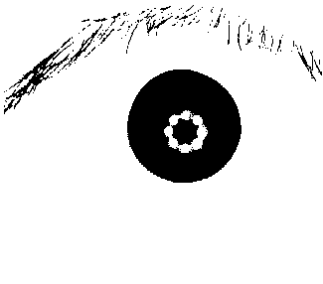
Input Image
Binarized Image with holes
Image after hole filling
Removal of Specular Highlights from Iris

Slide 30
Region of Interest Detection
A region of interest (ROI) is a portion of an image that you want to filter or operate on in some way.
You can represent an ROI as a binary mask image.
In the mask image, pixels that belong to the ROI are set to 1 and pixels outside the ROI are set to 0.
The Matlab toolbox offers several options to specify ROIs and create binary masks.
It supports a set of objects that you can use to create ROIs of many shapes, such circles, ellipses, polygons, rectangles, and hand-drawn shapes.
After you create the objects, you can modify their shape, position, appearance, and behavior.

Slide 31
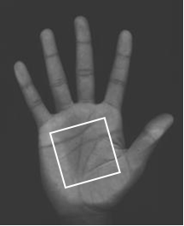
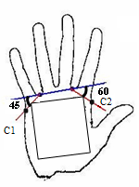
Palm print Extraction - ROI
Region of interest in Binary Image
Region of Interest in Original Image

Slide 32
Image Restoration
Image restoration is the operation of taking a corrupt/noisy image and estimating the clean, original image.
Corruption may come in many forms such as motion blur, noise and camera mis-focus.
Image restoration is performed by reversing the process that blurred the image and such is performed by imaging a point source and use the point source image, which is called the Point Spread Function (PSF) to restore the image information lost to the blurring process.

Slide 33
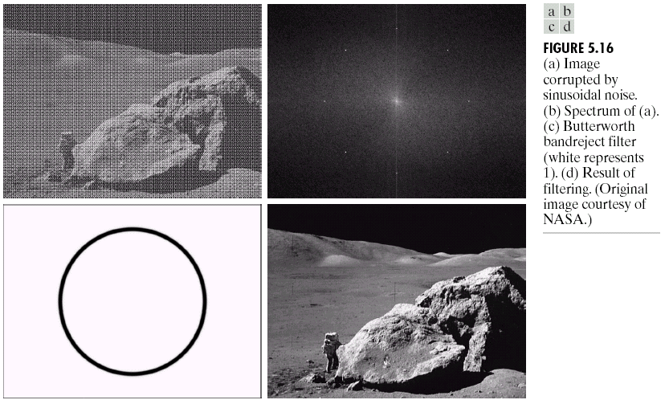
Image Restoration
Image restoration attempts to restore images that have been degraded
Identify the degradation process and attempt to reverse it
Similar to image enhancement, but more objective

Slide 34
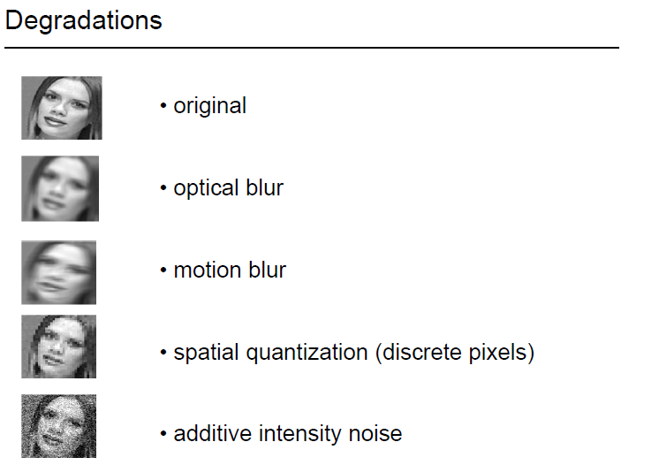
Image degradations

Slide 35
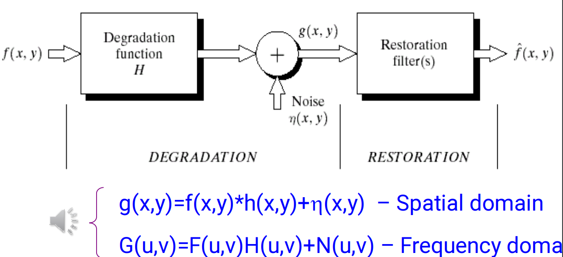
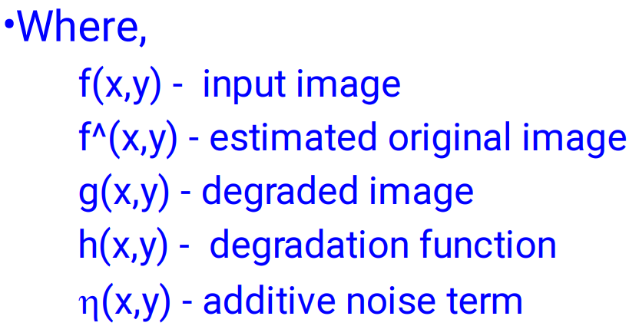
Image Restoration

Slide 36
Image Segmentation
Goal of Segmentation to simplify and/or change the representation of an image into something that is more meaningful and easier to analyze.
Image segmentation is a method in which a digital image is broken down into various subgroups called Image segments which helps in reducing the complexity of the image to make further processing or analysis of the image simpler.
Segmentation is assigning labels to pixels.
All picture elements or pixels belonging to the same category have a common label assigned to them.

Slide 37
Image Segmentation
For example: Let’s take a problem where the picture has to be provided as input for object detection.
Rather than processing the whole image, the detector can be inputted with a region selected by a segmentation algorithm.
This will prevent the detector from processing the whole image thereby reducing inference time.

Slide 38
Approaches in Image Segmentation
Similarity approach: This approach is based on detecting similarity between image pixels to form a segment, based on a threshold. ML algorithms like clustering are based on this type of approach to segment an image.
Discontinuity approach: This approach relies on the discontinuity of pixel intensity values of the image. Line, Point, and Edge Detection techniques use this type of approach for obtaining intermediate segmentation results which can be later processed to obtain the final segmented image

Slide 39
Image Segmentation Techniques
Threshold Based Segmentation
Edge Based Segmentation
Region-Based Segmentation
Clustering Based Segmentation
Artificial Neural Network Based Segmentation

Slide 40
Threshold based Segmentation
Image thresholding segmentation is a simple form of image segmentation.
It is a way to create a binary or multi-color image based on setting a threshold value on the pixel intensity of the original image
In this thresholding process, we will consider the intensity histogram of all the pixels in the image.
Then we will set a threshold to divide the image into sections.

Slide 41
Threshold based Segmentation
For example, considering image pixels ranging from 0 to 255, we set a threshold of 60.
So all the pixels with values less than or equal to 60 will be provided with a value of 0(black) and all the pixels with a value greater than 60 will be provided with a value of 255(white).
But this threshold has to be perfectly set to segment an image into an object and a background.

Slide 42
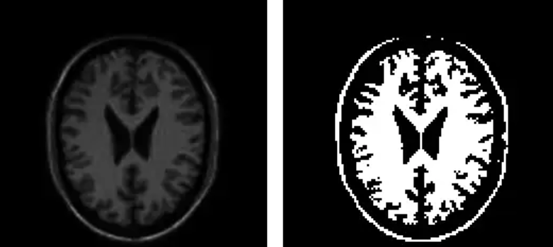
Threshold Based Segmentation

Slide 43
Edge Based Segmentation
Edge-based segmentation relies on edges found in an image using various edge detection operators.
These edges mark image locations of discontinuity in gray levels, color, texture, etc.
When we move from one region to another, the gray level may change. So if we can find that discontinuity, we can find that edge
We can use various edge detectors like Sobel edge operator, canny edge detector, Kirsch edge operator, Prewitt edge operator, Robert’s edge operator, etc.

Slide 44
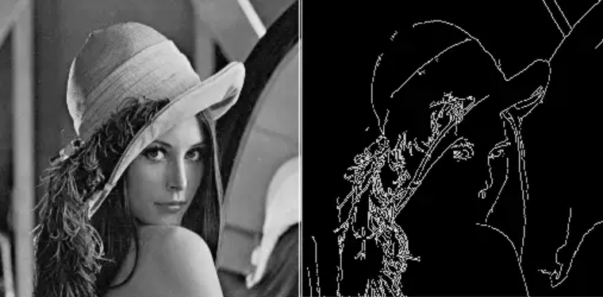
Edge Based Segmentation

Slide 45
Pattern classification and Extraction
Pattern is everything around in this digital world.
A pattern can either be seen physically or it can be observed mathematically by applying algorithms.
Example: The colors on the clothes, speech pattern, etc. In computer science, a pattern is represented using vector feature values.

Slide 46
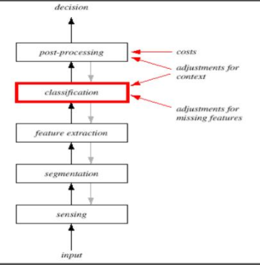
Steps in making decision

Slide 47
Pattern classification and Extraction
Sensing
The input to a pattern recognition system is often some kind of a transducer, such as a camera or a microphone array.
The difficulty of the problem may well depend on the characteristics and limitations of the transducer- its bandwidth, resolution, sensitivity, distortion, signal-to-noise ratio, latency, etc.

Slide 48
Pattern classification and Extraction
Segmentation and Grouping
We assumed that each object can be isolated, separate from others and could easily be distinguished from the Others.
In practice, the object would often be overlapping, and our system would have to determine where one ends and the next begins-the individual patterns have to be segmented.
If we have already recognized the object then it would be easier to segment their images.
Segmentation is one of the deepest problems in pattern recognition. Closely related to the problem of segmentation is the problem of recognizing or grouping together the various pans of a composite object.

Slide 49
Pattern classification and Extraction
Feature Extraction
The conceptual boundary between feature extraction and classification proper is somewhat arbitrary: An ideal feature extractor would yield a representation that makes the job of the classifier trivial; conversely, an omnipotent classifier would not need the help of a sophisticated feature extractor The distinction is forced upon us for practical rather than theoretical reasons.
As with segmentation, the task of feature extraction is much more problem- a domain-dependent and thus requires knowledge of the domain

Slide 50
Pattern classification and Extraction
Post Processing
The post-processor uses the output of the classifier to decide on the recommended action.
The simplest measure of classifier performance is the classification error rate -the percentage of new patterns that are assigned to the wrong category. Thus, it is common to seek minimum-error-rate classification.
We could also do better if we used multiple classifiers, each classifier operating on different aspects of the input.

Slide 51
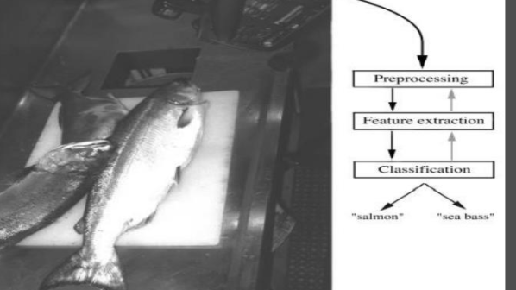
example

Slide 52
Fingerprint
Fingerprint Recognition and acquisition
Fingerprint features, matching and synthesis

Slide 53
Fingerprint
The fingerprint is a physical biometric aspect.
It is used to identify a person’s identity due to its uniqueness where no two persons can share the same fingerprint.
Besides, a fingerprint is unchangeable with time and can be easily recognized during the whole life of the individual.
The fingerprint is an impression or model of ribs and valleys at the top of a person’s fingers.

Slide 54
Fingerprint
Fingerprint recognition is the automatic process of comparing saved fingerprint pattern with the input fingerprint to determine human characters.
The fingerprint identification system is a cheap but solid mechanism at the same time. Moreover, it’s a simple way to identify humans speedily and accurately
Many applications applied fingerprint recognition such as the military, judiciary, health, teaching, civic serving, mobiles and laptop log-in, and many more.

Slide 55
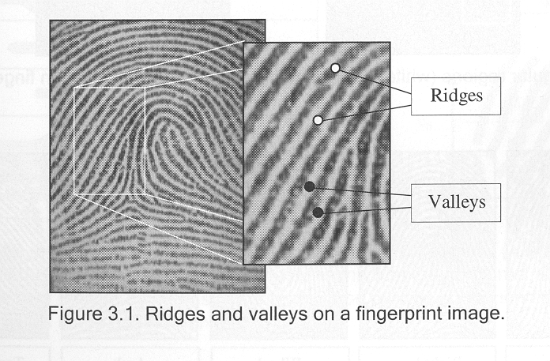
Introduction
Fingerprint
Interleaved ridges and valleys
Ridge width: 100μm-300 μm
Ridge-valley cycle: 500 μm

Slide 56
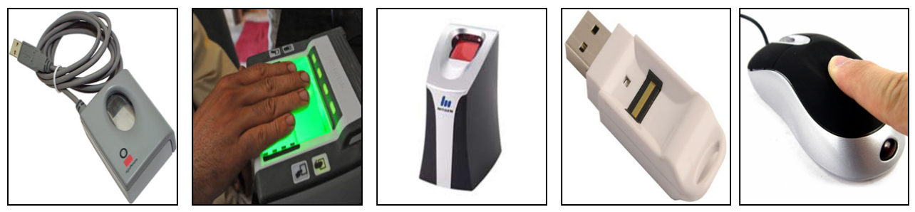
Fingerprint acquisition
Finger Print Scanners

Slide 57
Fingerprint Acquisition: Sensing Techniques
Digital images of the fingerprints can be acquired using off-line or on-line methods.
Off line Method:
Off-line techniques generally do not produce the digital image directly from the fingertip. Rather, the fingerprint is first transferred to a substrate (e.g., paper) that is subsequently digitized.
For example, an inked fingerprint image, the most common form of off-line capture, is acquired by first applying ink to the subject’s fingertip and then rolling or pressing the finger on paper, thereby creating an impression of the fingerprint ridges on paper.
This kind of fingerprint is often called rolled fingerprint.
A very important kind of off-line fingerprint image is the latent fingerprint: a partial fingerprint image lifted from a crime scene by a forensic expert. Compared to a rolled fingerprint, the latent is most of the times of bad quality and hard to process

Slide 58
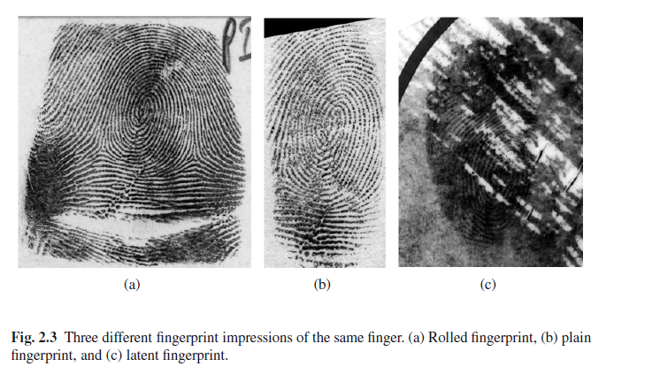
Different fingerprint impressions

Slide 59
On-line techniques
Online:
On-line techniques produce the digital image directly from a subject’s fingertip via digital imaging technology that circumvents the need for obtaining an impression on a substrate. The resulting fingerprint image is referred to as a live-scan fingerprint.
A typical fingerprint scanner comprises:
• a sensor to read the ridge pattern on the finger surface;
• an A/D (Analog to Digital) converter to convert the signal;
• an interface module responsible for communicating with
external devices.
Almost of all existing sensors belong to one of the following families: optical, solid-state and ultrasound. These sensors are also called touch sensors.
Notes:
on-line techniques produce the digital image directly from a subject’s
fingertip via digital imaging technology (described below) that circumvents
the need for obtaining an impression on a substrate. The resulting fingerprint image
is referred to as a live-scan fingerprint.

Slide 60
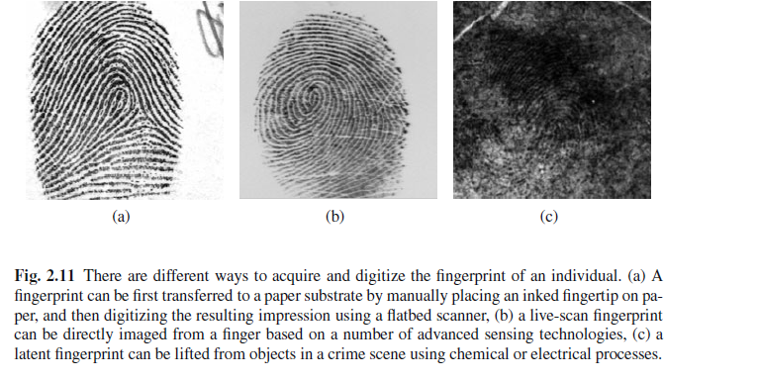
Different ways of acquiring

Slide 61
Fingerprint scanner operation methods
Plain fingerprint is obtained by simply placing the finger on the surface of fingerprint sensor.
A rolled fingerprint is obtained by rolling the finger from nail to nail on the surface of fingerprint sensor
Sweep fingerprint is obtained by combining narrow fingerprint slices .( typically 3mm wide) while the user swipes his finger across the sensor
Clarity of ridge pattern is another important determinant of quality.

Slide 62
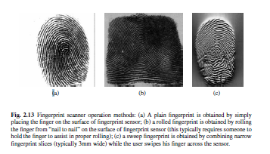

Slide 63
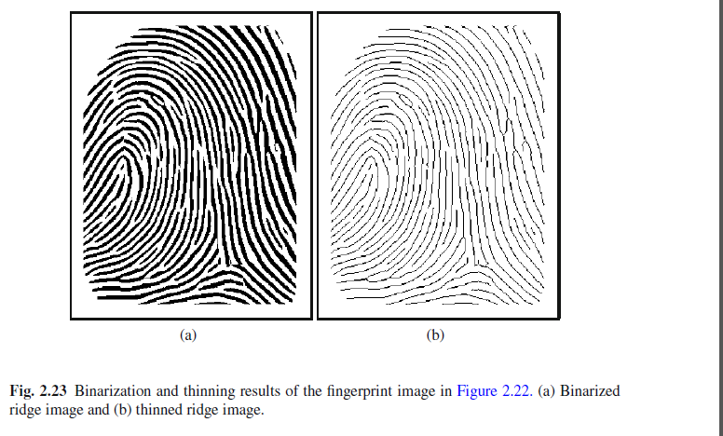
Binarization and thinning

Slide 64
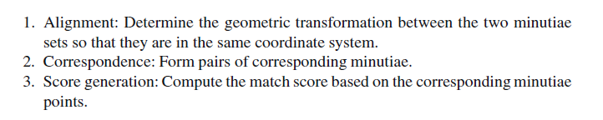
Three steps of matching

Slide 65
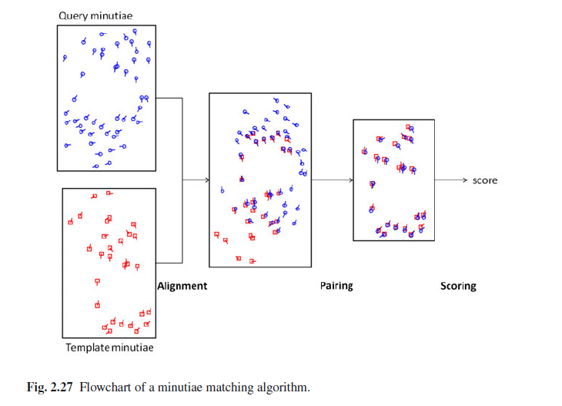
Minutiae matching algorithm

Slide 66
Alignment
Since two impressions of the same finger taken at different instances could differ due to different placement of the finger on the sensor, an alignment process is required to transform them to the same coordinate system.
This process, also known as registration, transforms one image in such a way that it is geometrically aligned with the other.
First, we need to specify a spatial transformation model

Slide 67
PAIRING
After the two minutiae sets are aligned, the corresponding minutiae are paired.
A minutia a in the template (reference) minutiae set is said to be in correspondence with minutia b in the query minutiae set if and only if their distance is within a predefined distance threshold (say, 15 pixels) and the angle between their directions is within another predefined angle threshold (say, 20 degrees)

Slide 68
SCORE
We need to compute a match score, which is then compared to a predefined threshold to classify the two fingerprints as a genuine match (they come from the same finger) or an impostor match (they come from two different fingers).
This problem can be viewed as a two-class classification problem with genuine match as class-1 and impostor match as class-2.

Slide 69
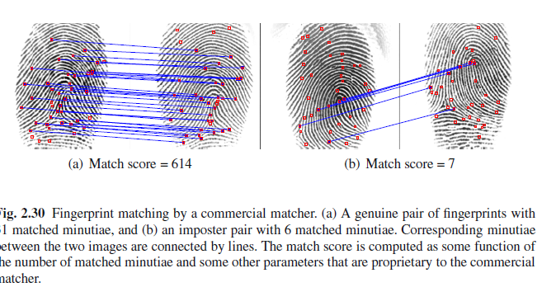
MATCH SCORE

Slide 70
PALMPRINT
Forensics application is concerned, the main benefit of using palmprints is in latent palmprint matching since it is estimated that about 30% of the latent found at crime scenes are those of palms.

Slide 71
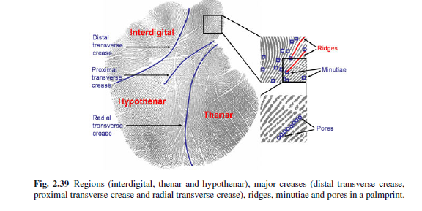
Palm print features

Slide 72
Challenges in Palm Print Recognition
Matching palmprints is more complicated than matching fingerprints.
First of all, in terms of image acquisition, it is more challenging to capture palmprints than fingerprints since the sensors are larger and more expensive and greater user cooperation is required to ensure a good quality palmprint image due to the concavity of the palm surface.

Slide 73
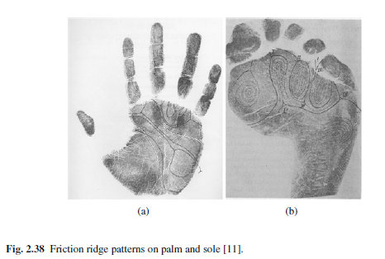
Friction ridge patterns

Slide 74
Face recognition
Face recognition and acquisition
Face detection, feature extraction and matching

Slide 75
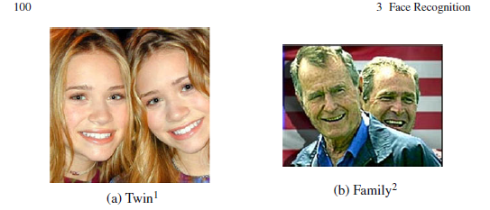

Slide 76
Face recognition
Face recognition can be defined as the process of establishing a person’s identity based on their facial characteristics
The problem of face recognition involves comparing two face images and determining if they are of the same person
Face images of a person may have variations in age, pose, illumination, and facial expressions exhibit changes in appearance due to make-up, facial hair, or accessories (e.g., sunglasses, hat etc)

Slide 77
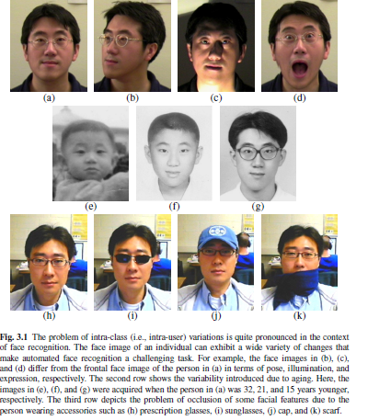

Slide 78
ADVANTAGES
Face can be captured at a longer standoff distance using non-contact sensors.
The face conveys not only the identity, but also the emotions of a person (e.g., happiness or anger) as well as biographic information(e.g., gender, ethnicity, and age).
Face recognition has a wide range of applications in law enforcement, civilian identification, surveillance systems, and entertainment/ amusement systems

Slide 79
Level 1 details
Consists of gross facial characteristics that are easily observable.
Examples include the general geometry of the face and global skin color. Such Features can be used to quickly discriminate between
(a) a short round face and an elongated thin face;
(b) faces exhibiting predominantly male and female characteristics;
(c) faces from different races.
These features can be extracted even from low resolution face images (< 30 interpupilary distance (IPD)1).

Slide 80
Level 2
Level 2 details consist of localized face information such as the structure of the face components (e.g., eyes, nose, mouth etc), the relationship between facial components and the precise shape of the face.
These features are essential for accurate face recognition, and they require a higher resolution face image (30 to 75 IPD).
The characteristics of local regions of the face can be represented using geometric or texture descriptors.

Slide 81
Level 3
Level 3 details consist of unstructured, micro level features on the face, which includes scars, freckles, skin discoloration, and moles.
One challenging face recognition problem where Level 3 details may be critical is the discrimination of identical twins

Slide 82
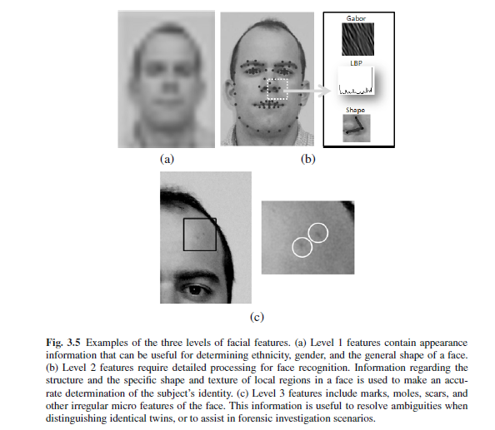
All three levels of facial features

Slide 83
Design of a face recognition system
A typical face recognition system is composed of three modules:
(a) image acquisition,
(b) face detection, and
(c) face matching

Slide 84
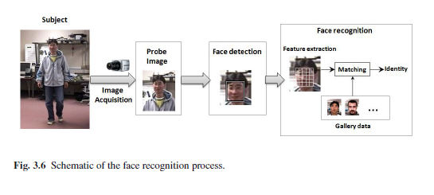

Slide 85
Image acquisition
Face image acquired from a sensor can be categorized based on
the spectral band (e.g., visible, infrared, and thermal) used to record the image
the nature of the image rendering technique (e.g., 2D, 3D, and video).
Since most of the automated face recognition systems make use of 2D images acquired in the visible spectrum

Slide 86
Face matching
Face matching is usually carried out by comparing the features extracted from the probe and gallery images

Slide 87
FACE DETECTION
Face detection is the first step in most face-related applications including face recognition, facial expression analysis, gender/ethnicity/age classification, and face modeling.
There are a number of approaches for detecting faces in a given image
State-of-the-art face detection methods are typically based on extracting local texture features from the given image and applying a binary (two-class) classifier to distinguish between a face and non-face

Slide 88
Face Detection:
Viola-Jones face detector: The Viola-Jones face detector scans through the input image with detection windows of different sizes and decides whether each window contains a face or not.
Viola-Jones face detector is not perfect and can produce both false positive and false negative errors
A false positive error refers to the detection of a face where none exists, while a false negative error indicates that a face present in the image was not detected.

Slide 89
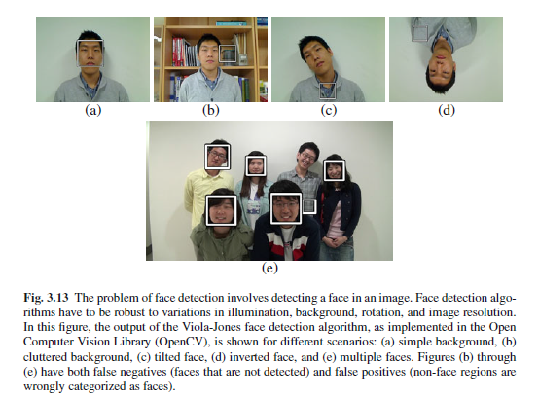

Slide 90
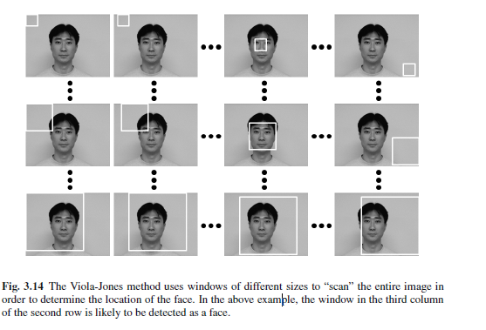
Viola-Jones face detector

Slide 91
Viola Jones Face Detector
The Viola-Jones face detector scans through the input image with detection windows of different sizes and decides whether each window contains a face or not.
Figure shows the scanning process ranging from small to large windows.
In each window, the existence of a face candidate is decided by applying a classifier to simple local features derived using rectangular filters

Slide 92
A Face Bunch Graph (FBG) model can be constructed in two stages from a training set of face images with a specific pose
In the first stage, the designer has to manually mark the desired fiducial points and define the geometric structure of the image graph for one (or a few) initial image(s).
The image graphs for the remaining images in the training set can be obtained semi-automatically, by comparing the new images to model graphs (images that have been already marked) based on the extracted Gabor jets.

Slide 93
During this process, manual intervention is required only if the fiducial points are identified incorrectly
Since all the training images have the same pose, the graphs corresponding to these face images will have the same structure
In the second stage, a FBG is obtained from the individual image graphs by combining a representative set of individual graphs in a stack-like structure.
Each node in the FBG is labeled by a set of Gabor jets that represent the local variations in the associated fiducial point among the population of users in the training set

Slide 94
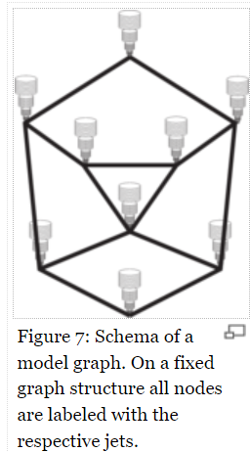

Slide 95
For example, an eye bunch may include jets from open, closed, male and female eyes, etc. that cover the variations in the local structure of the eye.
An edge between two nodes of the FBG is labeled based on the average distance between the corresponding nodes in the training set.
Typically, a separate FBG is constructed for each pose and the correspondence between the nodes of bunch graphs belonging to different poses is specified manually.

Slide 96
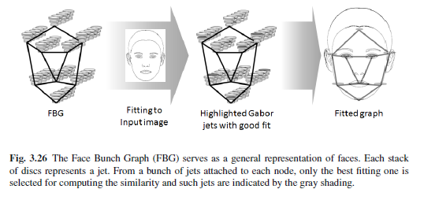

Slide 97
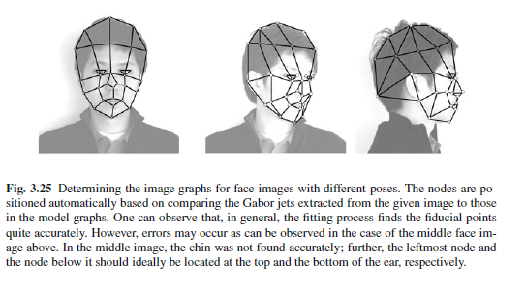

Slide 98
STEPS
1.Find the approximate face position by coarsely scanning the input image with a condensed FGB (an average graph obtained by taking the mean Gabor jets at each bunch).
This is achieved by extracting the Gabor jets at some discrete locations in the given image and comparing it to the jets in the condensed FBG, while taking into account the geometric structure of the FBG

Slide 99
STEPS
2. Refine the position and size of the face by searching the image again with the full FBG, whose size and aspect ratio is systematically varied.
When computing the similarity between a Gabor jet in the given image and a bunch of jets in the FBG, only the FBG jet that best matches with the given image jet is considered.
3. Precisely locate the fiducial points by moving all the nodes locally and relative to each other to optimize the graph similarity further.

Slide 100
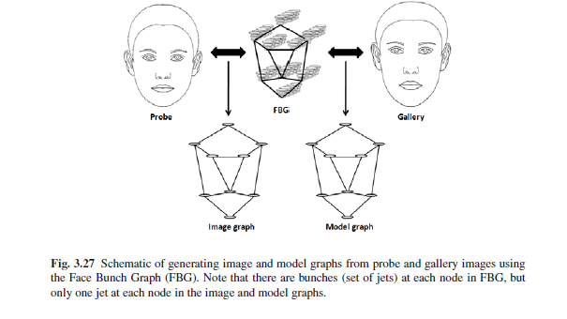
FBG

Slide 101
Texture-based face recognition
Texture of an image uses the distribution of local pixel values.
Scale Invariant Feature Transformation (SIFT) and Local Binary Pattern (LBP) are two most well known schemes for analysis of local texture
Scale Invariant Feature Transform: Scale Invariant Feature Transform (SIFT) is one of the most popular local representation schemes used in object recognition.
key point extraction,
(b) descriptor calculation in a local neighborhood at each key point.

Slide 102
Texture-based face recognition
Just like the fiducial points in the model-based approach, the key points can be used to achieve tolerance against pose variations
The face image is typically divided with multiple patches and the SIFT descriptor is constructed from each patch.
The final descriptor is obtained by concatenating all the descriptors from all the patches

Slide 103
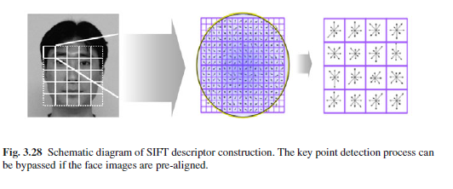

Slide 104
LBP
Local Binary Pattern
Local Binary Pattern (LBP) has been successfully used as a local texture descriptor in general object recognition as well as in face recognition
LBP features are usually obtained from image pixels of a 3×3 neighborhood region
The basic LBP operator compares the 8 neighboring pixel intensity values to the intensity value of the central pixel in the region and represents the result as a 8-bit binary string.

Slide 105
MLBP
Multi-scale LBP (MLBP) is an extension of the basic LBP
MLBP introduces a radius parameter R, which means that the compared neighbors are R pixels away from the center pixel. There is also another parameter P, which is the number of sampling points along the circle of radius R.
If a sampling point is off the pixel grid, bilinear interpolation of pixel values can be applied to obtain the intensity value of the sampling point.
The MLBP operator with parameter
Generally,MLBP with larger value of P provides more detailed information about the local region. However, when P becomes larger, the dimension of the descriptor also increases.
MLBP operators with different values of R encode different local image structures, ranging from micro to macro details

Slide 106
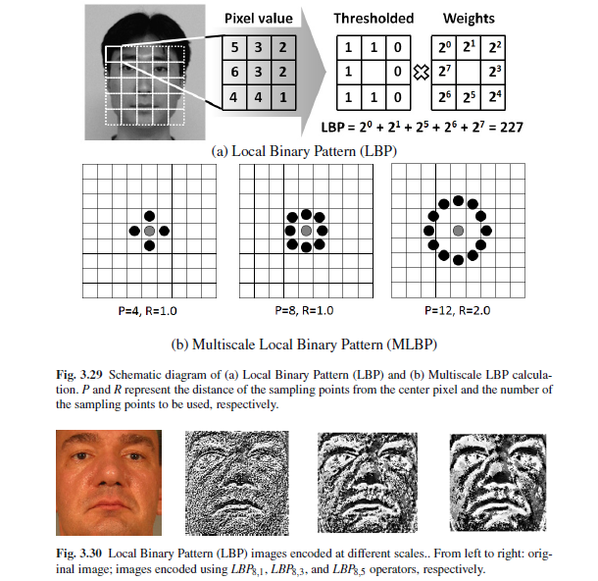

Slide 107
IRIS
Iris recognition and acquisition
Iris Segmentation, normalization and matching

Slide 108
IRIS RECOGNITION
The use of the ocular region as a biometric trait has gained importance, especially due to significant advancements made in iris recognition since 1993.
The ocular region of the human face consists of the eyes and the surrounding structures such as facial skin, eyebrows, and nose bridge

Slide 109
IRIS
The iris is an internal organ of the eye that is located just behind the cornea and in front of the lens.
The primary function of the iris is to regulate the amount of light entering the eye by dilating or contracting a small opening in it called the pupil.
The iris contracts the pupil when the ambient illumination is high and dilates it when the illumination is low.

Slide 110
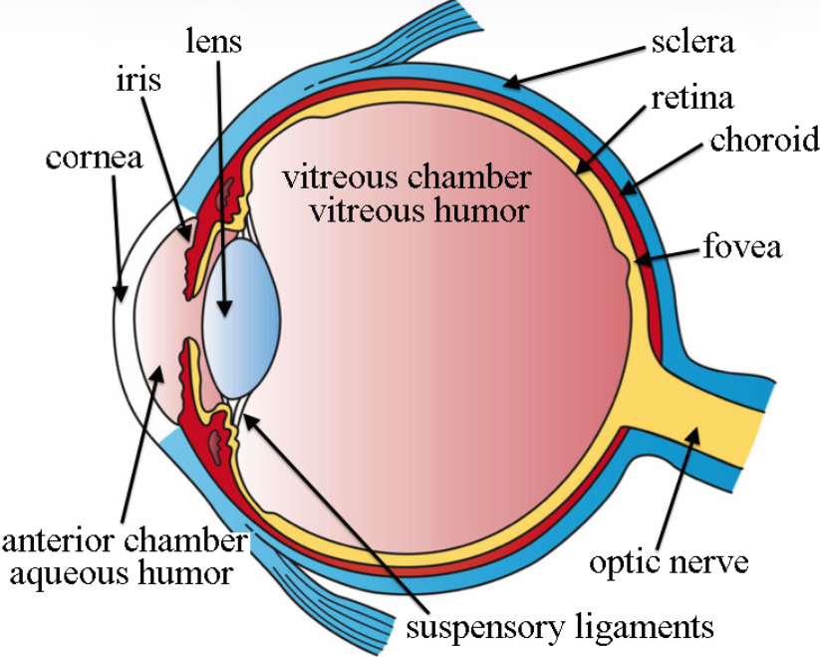
IRIS

Slide 111
LAYERS OF IRIS
The iris is a multilayered structure and a cross-section of the iris reveals the following layers:
The posterior layer: at the back, which is two cells thick, contains heavily pigmented epithelial cells, making it impenetrable to light.
The muscle layer: Above it consists of the sphincter and dilator muscles that contract and dilate the pupil

Slide 112
LAYERS OF IRIS
The Stromal layer: located above the muscles, is made up of collagenous connective tissue (arranged in an arch-like configuration) and blood vessels (arranged along the radial direction).
The anterior border layer: is the foremost layer and has an increased density of chromatophores (i.e., pigment containing cells) compared to the stromal layer

Slide 113
ANTERIOR PORTION
The anterior portion of the iris - consisting collectively of the muscles, stroma, and the border layers - is the foremost visible portion of the iris.
Therefore, it can imaged by a camera and is the focus of all automated iris recognition systems.

Slide 114
IRIS IMAGE
Figure shows an image of the iris as viewed by a near-infrared camera.
The iris, from this perspective, appears as an annular entity bound by the pupillary boundary (that separates it from the dark pupil) and the limbus boundary (that separates it from the white sclera).

Slide 115
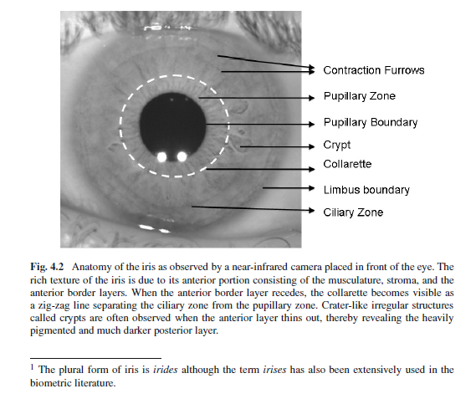
IRIS IMAGE

Slide 116
IRIS ZONES
The iris image is partitioned into two zones: the central pupillary zone and the surrounding ciliary zone.
These two zones are divided by a circular zigzag ridgeline known as the collarette.
Many pit-like irregular structures appear mainly in the region around the collarette. These structures are called crypts (Fuchs crypts) and they permit fluids to quickly enter and exit the iris during dilation and contraction of the pupil.
Near the outer part of the ciliary zone, concentric lines can be seen, especially in case of darkly pigmented irides1. These lines become deeper as the pupil dilates and are called contraction furrows. In the pupillary zone, radial furrows are observed.

Slide 117
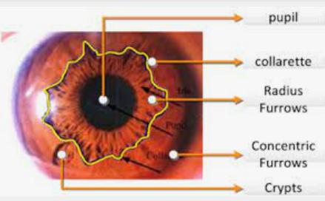
IRIS ZONES

Slide 118
IRIS
The color of the iris is primarily defined by the pigmentation present in it. The pigmentation itself is controlled by the number of melanin granules - a genetically determined factor.
However, other factors, such as the cellular density of the stroma, can also affect the color of the iris.
The color of the iris does not play a significant role in iris recognition systems.
It is the texture detail present in the anterior portion of the iris that is useful for recognition.

Slide 119
Design of an Iris Recognition System
An iris recognition system may be viewed as a pattern matching system whose goal is to compare two irides and generate a match score indicating their degree of similarity or dissimilarity.
Thus, a typical iris recognition system has four different modules:
The acquisition
Segmentation
Normalization, and
Encoding/matching modules.

Slide 120

BLOCK DIAGRAM OF IRIS RECOGNITION SYSTEM

Slide 121
ACQUISITION
Acquisition: The role of the acquisition module is to obtain a 2D image of the eye using a mono chrome CCD camera that is sensitive to the near-infrared (NIR) range of the electromagnetic spectrum.
An external source of NIR light, often co-located with the acquisition system, is used to illuminate the iris.
Most iris recognition systems require the participating individual to be cooperative and to place their eye in close proximity to the camera.

Slide 122
SEGMENTATION
Segmentation: The segmentation module localizes the spatial extent of the iris in the image of the eye by isolating it from other structures present in its vicinity. These structures include the sclera, the pupil, the eyelids, and the eyelashes.
Typically, segmentation is accomplished by detecting the inner and outer boundaries of the iris (commonly referred to as the pupillary boundary and the limbus boundary, respectively), and the eyelids and eyelashes that can interrupt the circular contour of the limbus boundary.

Slide 123
SEGMENTATION
These segmentation techniques model iris boundaries and the two eyelids with simple geometric models.
Pupil and limbus are often modelled as circles and the two eyelids are modelled as parabolic arcs.
It is desired to distinguish the iris texture from the rest of the image.
The integro-differential operator, Hough transform and active contour models are commonly used to detect the boundaries of the iris.

Slide 124

SEGMENTATION

Slide 125
NORMALIZATION
Normalization: Once the inner and outer boundaries of the iris are estimated, a geometric normalization scheme is invoked to transform the iris texture within the annular region from cartesian coordinates to pseudo polar coordinates via a Rubber Sheet Model. This process is called as the “unwrapping of the iris”
It results in a rectangular entity whose rows correspond to the angular direction in the original iris and whose columns correspond to its radial direction.

Slide 126

NORMALIZATION

Slide 127
Encoding and Matching:
Encoding and Matching: While the unwrapped iris may be directly used to compare two irides (e.g., by using correlation filters), typically a feature extraction routine is used to encode its textural content.
Most encoding algorithms perform a multi-resolution analysis of the iris by applying wavelet filters and examining the ensuing response.
A commonly used encoding mechanism uses quadrature 2D Gabor Wavelets to extract the local phasor information of the iris texture.
Each phasor response is then encoded using two bits of information based on the quadrant of the complex plane in which it lies. The resulting 2D binary code is referred to as the iris code

Slide 128
Two such iris codes can be compared using the Hamming distance, which computes the number of corresponding bits that are different across them;
The binary mask computed in the segmentation module is used to ensure that only bits corresponding to valid iris pixels are compared.

Slide 129
Ear
Ear recognition
Ear detection

Slide 130
Ear
The human ear is observed to exhibit variations across individuals as assessed by the curves, surfaces, and geometric measurements pertaining to the visible portion of the ear, commonly referred to as the pinna.
The structure of the pinna depicting various anatomical features can be seen in Figure

Slide 131

EAR

Slide 132
The Ear offers several advantages
(a) the structure of the ear has been observed to be stable despite aging, and ear growth is almost linear after the age of four
(b) the ear, unlike other facial features, is minimally impacted by changes in facial expression; and
(c) image acquisition does not involve explicit
contact with the sensor.

Slide 133
EAR RECOGNITION SYSTEM
A typical ear recognition system consists of the following components:
(a) An ear detection module (also known as segmentation) that localizes the position and spatial extent of the ear in an image
(b) a feature extraction module that extracts discriminative features from the ear
(c) a matching module that compares the features extracted from two ear images and generates a match score; and
(d) a decision module that processes the match score(s) and establishes the identity of the subject.

Slide 134
Ear detection
1. Template Matching
2. Model-based Detection
3. Morphological-operator-based Detection
4. Face-geometry-based Detection

Slide 135
TEMPLATE MATCHING
Template Matching:
In a template matching scheme, a template of a typical ear is constructed and is matched with each location in the query image.
The location giving the highest score is considered as the region containing the ear.
The template may consist of an edge image of the ear or a set of descriptors extracted from the ear such as the response to a set of filters or a histogram of shape curvatures in case a 3D image of the ear is being used for recognition

Slide 136
Model based detection
A model-based detection technique assumes certain characteristics of the shape of the ear and tries to find regions that manifest such characteristics.
The shape of the helix, for example, is usually elliptical so a generalized Hough transform tuned for detecting ellipses can be used to locate the ear in an edge image.

Slide 137
Morphological-operator-based Detection
Since the structure of the ear is usually more intricate than the structure of the remaining region in a profile face image, morphological transformations such as the Top-hat transformation can be used.
A Top-hat transformation essentially subtracts a morphologically smoothened version of an image from itself, thereby highlighting finer details.

Slide 138
Face-geometry-based Detection
Since in a profile image the nose can be easily detected as the point with high curvature, it is possible to constrain the search for the ear in an appropriate location relative to the nose.

Slide 139
Ear recognition
Subspace analysis-based techniques
Sparse representation-based techniques
Point set matching-based techniques
Image filtering-based techniques
Geometric measurements-based techniques
Transformation-based techniques
3D techniques

Slide 140
Subspace analysis-based techniques
Projecting the ear image onto a set of principal directions is an effective way to obtain a salient and compact representation of an ear.
Subspace projection techniques such as PCA, and LDA have been successfully used in literature for matching ear images.
Manifold learning based techniques such as Locally Linear Embedding (LLE) and Kernel PCA have also been used to perform ear recognition.

Slide 141
Sparse representation-based techniques
Optimization techniques that minimize L-1 norm of the distance vector between the transformed query and all the transformed templates in a database have been shown to provide high recognition accuracy in object recognition studies.
This technique has also been successfully used for ear recognition.

Slide 142
Point set matching-based techniques
Elastic bunch graph matching is an effective technique to recognize faces based on responses to a bank of Gabor filters at some nodal points on the face.
This technique has also been successfully used for matching ear images where a number of landmark points can be easily detected, thanks to its complex structure.
Scale Invariant Feature Transform (SIFT) is a well known technique for matching two images where a set of salient points can be reliably and repeatably extracted from them.

Slide 143


Slide 144
Image filtering-based techniques
In certain techniques, the ear image is first enhanced to highlight the discriminative features and suppress the noise.
Two common techniques that use this basic procedure are
force field transformation and
local binary patterns

Slide 145
Force field transformation
A force field transformation obtains the intensity of the forces at each location in the image where each pixel is considered as a source of the force with intensity proportional to its value.
Force field transformation has been shown to effectively remove the noise in the ear image leading to significant improvement in recognition accuracy.
Further, a set of lines indicating the gradients of this force field can be extracted and used for matching.
Figure for a depiction of force field extracted from an ear image with the force field lines marked.

Slide 146


Slide 147
Local binary patterns
Local binary patterns essentially characterize each pixel based on variation of intensity of that pixel along a set of directions.
The variation along each direction is encoded as a single bit indicating whether the intensity is increasing or decreasing, and the set of bits associated with each direction is used to obtain an integer value for each pixel.
Such a transformation effectively reduces the effect of illumination variations and other sources of noise, thereby generating an enhanced image which can be used for robust matching.

Slide 148
Geometric measurements-based techniques
Features obtained by measuring certain geometric characteristics of the ear can also be used as a set of discriminative features.
As an example, the centroid of a near image obtained from its edge image can be used as a center to draw concentric circles with pre-specified radii.
Various measurements, such as number of points on a circle intersecting the edge image or distance between two consecutive intersections, can be used as a feature vector.

Slide 149
Transformation-based techniques
Various image transformation techniques such as Fourier transform or wavelet transform can also be applied to extract discriminative features from an ear image.
Fourier transform can also be applied in order to obtain a rotation and translation invariant representation of the ear –
For example, by using a polar coordinate system and extracting only the magnitude of the Fourier transform.

Slide 150
3D Techniques
3D images offer depth information that can be used in conjunction with the 2D texture information to improve the recognition accuracy.
In the case of 3D ear images, local histograms of shape curvature values can be used to match two ear images.
The Iterative Closest Point (ICP) algorithm is commonly used to register and match 3D ears.
In the ICP technique, each point in the input ear image is used to obtain a corresponding point in the template image and the input is then rotated and translated in order to minimize the distances between corresponding points.

Slide 151
Challenges in ear recognition
There are no commercial biometric systems at this time that explicitly utilize features of the ear for human recognition.
But the performances of ear recognition algorithms have been tested on some standard ear datasets. Experiments suggest that ear images obtained under controlled conditions can result in good recognition accuracy.
1. Ear Occlusion
2. Earprint Identification

Slide 152
Ear Occlusion
One of the main challenges faced by an ear recognition system is occlusion due to the subject’s hair.
One way to address such occlusion is by capturing the thermogram along with the visible light image.
In a thermogram, the hair can be easily detected (and possibly isolated) as its temperature is usually lower than that of the skin.

Slide 153
Ear print identification
Earprints, or earmarks, are marks left by secretions as a result of pressing the ear against a flat surface.
These marks mainly consist of impressions of the helix, anti-helix, tragus, and anti-tragus.
Other features include the earlobe and the crus of helix, but they are less frequently observed.
Earprints can be compared based on details such as the notches and angles in imprinted samples, the positions of moles, folds, and wrinkles, and the position of pressure points

Slide 154
Earprint identification is usually manually performed by identifying and matching a set of geometric features from the earprint such as the intersection points of ear curves with a regular grid or locations of certain other landmark points.

Slide 155
Hand Geometry
Hand geometry, as the name suggests, refers to the geometric structure of the hand.
This structure includes width of the fingers at various locations, width of the palm, thickness of the palm, length of the fingers, contour of the palm, etc.
Although these metrics do not vary significantly across the population, they can still be used to verify the identity of an individual.
Hand geometry measurement is non-intrusive and the verification involves a simple processing of the resulting features.
Unlike palmprint, this method does not involve extraction of detailed features of the hand

Slide 156
Hand Geometry
A typical hand geometry system consists of four main components:
Image acquisition,
Hand segmentation and alignment,
Feature extraction,
Feature matching.

Slide 157
Image capture
Contact-based vs Contactless:
A typical system requires the user to place her hand on a flat surface prior to capturing. Such systems are contact-based and require explicit cooperation of the subject being identified.
To address these issues, contactless recognition systems have been proposed. However, such systems are required to address the intra-class variability in the captured images due to the articulation of the hand in all three dimensions.

Slide 158
Image capture
Dorsal vs Palmar
An image of the hand is acquired by placing the hand on a flat surface and imaging the back of the hand with a CCD camera.
However, there has been interest in capturing the ridge patterns present on the palm and fingers along with the hand shape by imaging the palmar aspect of the hand
Drawback of such a system is that it is rather inconvenient for a user to place the hand on a platen with the palm facing upward.

Slide 159
Image capture
Peg-based vs Pegless:
In order to guide the positioning of the hand on the platen for imaging purposes (e.g., to prevent the fingers from touching each other), a few pegs are usually placed on the sensor platen.
It adds to the complexity of using the system and, thus, greater inconvenience to users.

Slide 160

Image capture
The image acquisition system comprises of a light source, a camera, a single mirror and a surface (with five pegs on it)
Pegs serve as control points for appropriate placement of the right hand of the user
A 640 by 480 8-bit grayscale image of the hand is captured

Slide 161
Hand segmentation
The hand boundary must be extracted in order to determine the region of interest.
The segmented hand may be further divided to obtain smaller segments corresponding to individual fingers.
Features can then be extracted separately from each of these segments.

Slide 162
Feature Extraction
Two kinds of features are extracted from a hand or a finger silhouette:
one-dimensional geometric measurements and two-dimensional shape-based features.
The geometric measurements include length and width of fingers, length and width of the palm, and thickness of the fingers.

Slide 163
Feature Extraction
It is also possible to use the set of points along the contours of the silhouette (or the segmented image itself) as features.
The dimensionality of these features can be reduced in order to obtain a more discriminative and compact representation of the hand.
16 axes along which the various features mentioned above have been measured
The hand is represented as a vector of the measurements selected above

Slide 164

Feature Extraction
is the gray values of the pixels along a axis
A sequence of pixels along a measurement axis will not have an ideal gray scale profile
Background lighting, color of the skin, noise and etc.

Slide 165

Feature Extraction
Result

Slide 166
Feature matching
The features extracted from a segmented hand image can often be denoted as a feature vector in the Euclidean space.
Common distance measures such as Euclidean and Manhattan distances can be effectively used to compare two hand images
Mahalanobis distance
ML algorithms such as SVM

Slide 167
Why Hand Geometry
What is the most effective biometric measurement?
Each biometrics has its strengths and limitation
It’s depend on application
User acceptability is the most significant factor
For many access control applications, like dormitory meal plan access, very distinctive biometrics, e.g., fingerprint and iris, may not be acceptable
Hand geometry-based verification systems are not new and have been available since the early 1970s

Slide 168
A Biometric Identification System Based on Eigen-palm and Eigen-finger Features
The identification process can be divided into the following phases:
Capturing the image
Preprocessing, extracting and normalizing the palm and strip-like finger subimages
Extracting the eigenpalm and eigenfinger features based on the PCA
Matching and fusion
A decision based on the (k, l)-NN classifier and thresholding

Slide 169

System Description

Slide 170
Preprocessing and Sub-images Extraction
(a) Example of a scanned hand image. (b) Binerized hand image.

Slide 171

Preprocessing and Sub-images Extraction
(a) The hand contour and the relevant points for finding the regions of interest. (b) Processed finger on the hand contour.

Slide 172
Geometry and Lighting Normalization
(a) Original hand image with the regions of interest marked on it. (b) Palm subimage. (c) Little-finger subimage. (d) Ring-finger subimage.
(e) Middle-finger subimage. (f) Index-finger subimage. (g) Thumb subimage.

Slide 173

Geometry and Lighting Normalization
After the subimages have been extracted, a lighting normalization using histogram fitting is applied.
In this process, a target histogram G(l) is selected for each of the six subimage
Subimages (a) before and (b) after the histogram fitting.

Slide 174
Lighting Normalization
Palm sub-images with the corresponding histograms (a) before and (b) after the histogram fitting.

Slide 175
Extraction of the Eigenpalm and Eigenfinger Features
Average palm and finger images from database.
Eigenpalms and eigenfingers obtained from the database (indicated by the corresponding ordinal numbers): (a) the eigenpalms and (b) the little-finger eigenfingers.

Slide 176
MATCHING AND FUSION AT THE MATCHING-SCORE LEVEL
The matching between corresponding feature vectors is based on the Euclidean distance
The distances are normalized and transformed into similarity measures
The frequency distribution of the distances of templates of the same person is calculated.

